Slide 1

Yes, Windows does have a Package Manager!
Presented by Alexandru Constantin

Slide 2
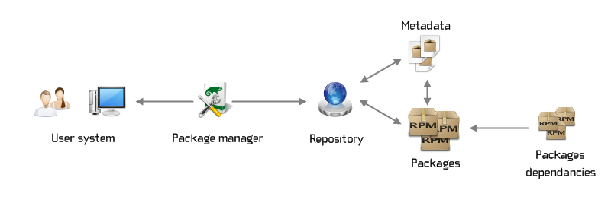
What is a package manager?
A package manager (PM) is a tool that automates the process of installing, updating, configuring, and managing software packages.

Slide 3
Benefits of a PM
Efficient
Consistent
Security
Convenience
Dependency management
Easy management of content
Why do people use PMs?

Slide 4
Types of package managers
Programming language specific:
Python ( pip )
Java ( Maven, Gradle )
Javascript ( npm, yarn, pnpm )
Operating System specific:
Linux ( apt, pacman, yum )
MacOS ( Homebrew )
Windows ( winget )

Slide 5
How to use winget?

Slide 6
Installing packages
> winget install -e --id OpenJS.NodeJS
How to install NodeJS through winget

Slide 7
View packages
> winget list
How to view all installed packages

Slide 8
View updates for packages
> winget update --include-unknown
How to view available software updates

Slide 9
Updating packages
> winget update --include-unknown –all
How to update packages through winget

Slide 10
Uninstall packages
> winget uninstall <package>
How to remove unwanted programs
Notes:
winget uninstall youtube-dl

Slide 11
Thank you for listening to me!
2024 Copyright © by INPROTED - International Professionals for Technology and Education. All rights reserved

